Slide 1

Principal Component
Analysis

Slide 2
Principal Component Analysis
Our discussions of unsupervised learning have focused on clustering techniques, which seek to “discover” labels on feature data that has no historical labels.
We will now shift towards unsupervised algorithms that focus on dimension reduction.

Slide 3
Principal Component Analysis
Motivation of Dimension Reduction:
Imagine a dataset with 30+ features, how would you understand the key features?
Visualization and Data Analysis have limitations when the number of feature dimensions increases.

Slide 4
Principal Component Analysis
Dimensionality Reduction Outcomes:
Understand which features describe the most variance in the data set.
Aid human understanding of large feature sets, especially through visualization.

Slide 5
Principal Component Analysis
Important Note:
Dimensionality Reduction algorithms such as PCA do not simply choose a subset of the existing features.
They create new dimensional components that are combinations of proportions of the existing features.

Slide 6
Principal Component Analysis
Section Overview
Theory and Intuition of PCA.
Manually create PCA Algorithm.
Utilize Scikit-Learn to perform PCA.
PCA Exercise Project Overview
PCA Exercise Solution

Slide 7
Let’s get started!

Slide 8
Principal Component
Analysis
Theory and Intuition - Part One

Slide 9
Principal Component Analysis
Let’s quickly cover the history and motivation behind the main ideas of PCA (Principal Component Analysis).
Later on we will focus on the mathematics of PCA.

Slide 10
Principal Component Analysis
1901: Karl Pearson publishes “On Lines and Planes of Closest Fit to Systems of Points in Space” based on the principal axis theorem in the field of geometry.
Pearson was the protégé of Francis Galton and the Pearson Correlation Coefficient is named after him.

Slide 11
Principal Component Analysis
1933: American mathematician and economist Harold Hotelling independently develops and names Principal Component Analysis in this publication, “Analysis of a complex of statistical variables into principal components”.

Slide 12
Principal Component Analysis
Hotelling’s paper perfectly describes the purpose of PCA:
Analyzing a complex set of variables into its principal components.
Let’s review the motivation and basic idea behind Principal Component Analysis.

Slide 13
Principal Component Analysis
Principal Component Analysis Outcomes:
Reduce number of dimensions in data.
Show which features explain the most variance in the data.

Slide 14
Principal Component Analysis
Dimension Reduction

Slide 15
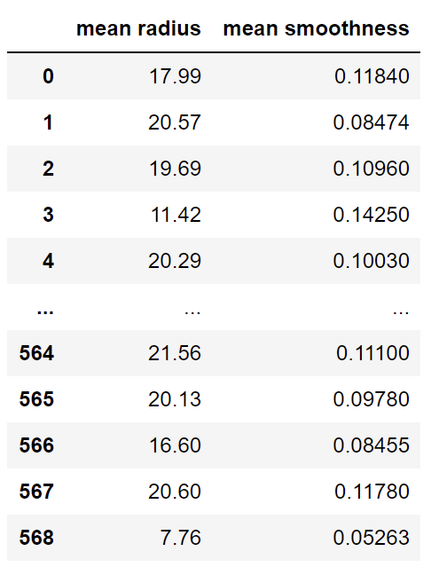
Principal Component Analysis
Dimension Reduction

Slide 16
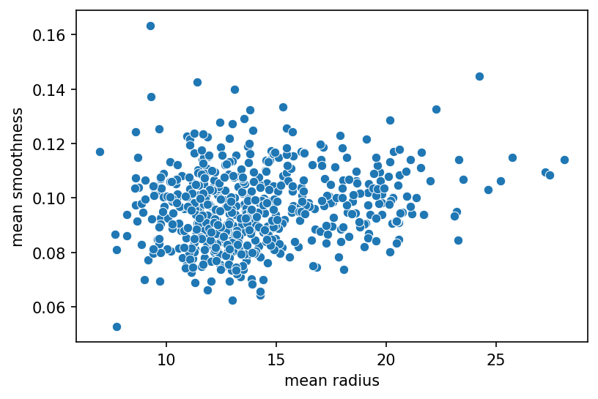
Principal Component Analysis
Dimension Reduction

Slide 17
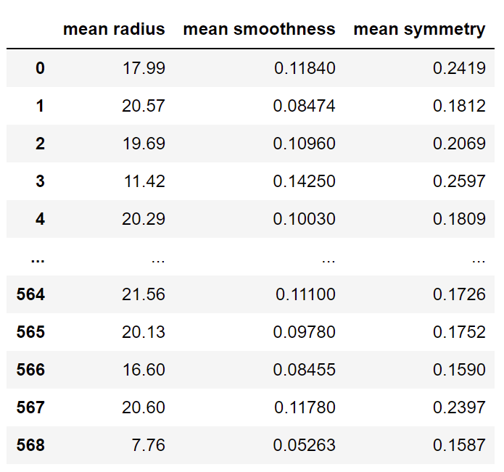
Principal Component Analysis
Dimension Reduction

Slide 18
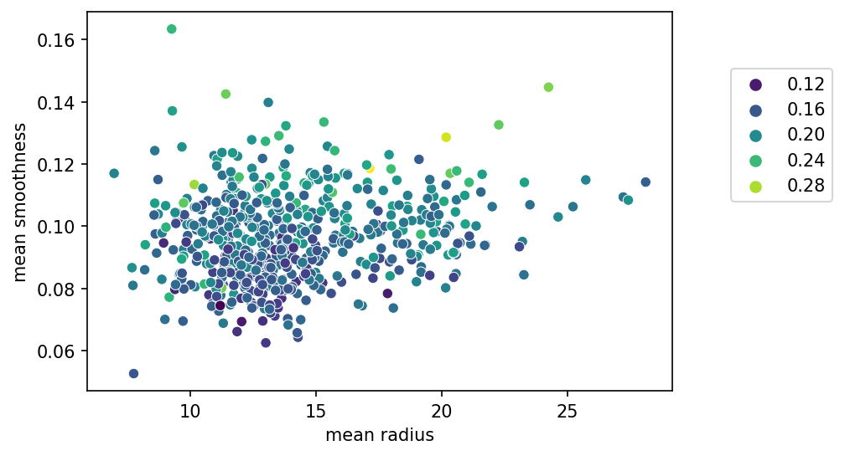
Principal Component Analysis
Dimension Reduction

Slide 19
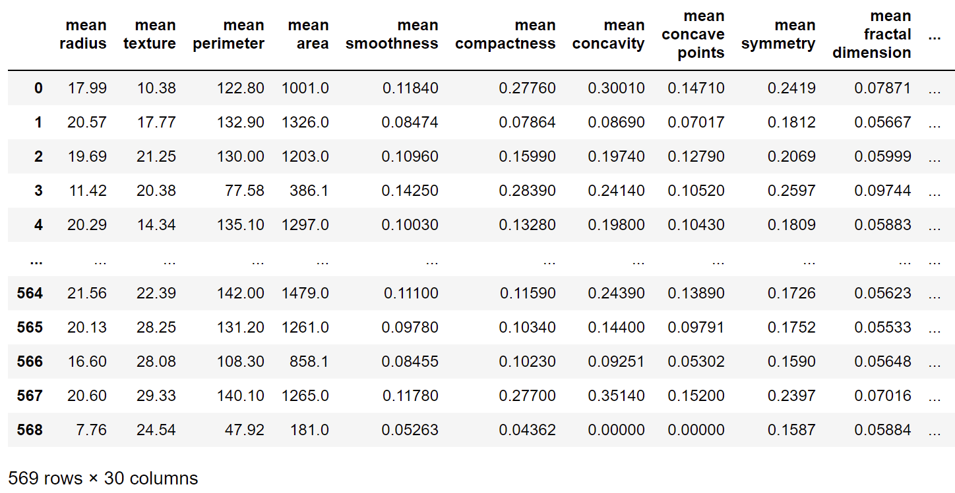
Principal Component Analysis
Dimension Reduction

Slide 20
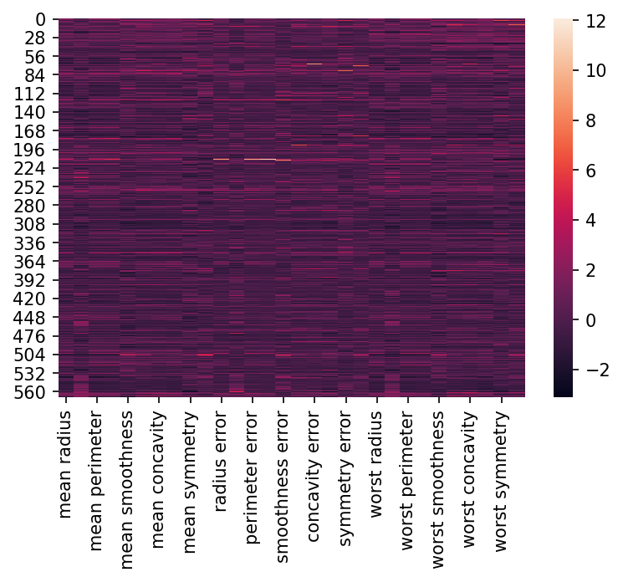
Principal Component Analysis
Dimension Reduction

Slide 21
Principal Component Analysis
Dimension Reduction
Helps visualize and understand complex data sets.
Can also act as a simpler data set for training data for machine learning algorithms.
Reduce dimensions then train ML Algorithm on smaller data set.

Slide 22
Principal Component Analysis
Dimension Reduction
Helps reduce N features to a desired smaller set of components through a transformation.
It does not simply select a subset of features.

Slide 23
Principal Component Analysis
Variance Explained

Slide 24
Principal Component Analysis
Variance Explained
We’ve often seen that certain features are more important or have more explanatory power than other features.
For example, size of a house is probably much more important than the color of a house when explaining the price of a house for sale.

Slide 25
Principal Component Analysis
Variance Explained
This idea of more important features is easy to understand when we can directly correlate features to a known label. But what about unlabeled data?
What measurement can we use to determine feature “importance”?

Slide 26
Principal Component Analysis
Variance Explained
Measure the proportion to which each feature accounts for dispersion in the data set.

Slide 27
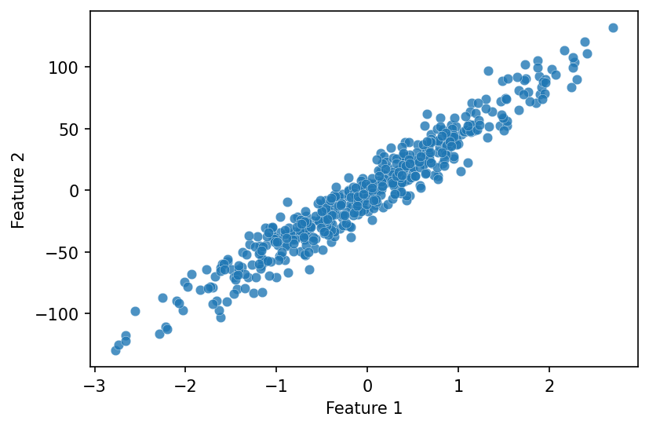
Principal Component Analysis
Variance Explained

Slide 28
Principal Component Analysis
Variance Explained

Slide 29
Principal Component Analysis
Variance Explained

Slide 30
Principal Component Analysis
Variance Explained

Slide 31

Principal Component Analysis
Variance Explained

Slide 32
Principal Component Analysis
Variance Explained
Principal Component 1

Slide 33
Principal Component Analysis
Variance Explained
Principal Component 1

Slide 34
Principal Component Analysis
Variance Explained
Principal Component is a linear combination of original features.
The more variance the original feature accounts for, the more influence it has over the principal components.

Slide 35
Principal Component Analysis
Variance Explained
Here we went from 2 features down to 1 principal component.
This single principal component can “explain” some percentage of the original data, for example 90% of variance explained by principal component.

Slide 36
Principal Component Analysis
Variance Explained
100% of the variance in the data is explained by all the original features.
We trade off some of the explained variance for less dimensions.
This can be significant savings for data sets with many dimensions, but only a few strong features.

Slide 37
Principal Component Analysis
Let’s continue by exploring how Principal Component Analysis actually works mathematically.

Slide 38
Principal Component
Analysis
Theory and Intuition - Part Two

Slide 39
Principal Component Analysis
Suggested Reading:
Section 10.1 of ISLR covers the topic of Principal Component Analysis.

Slide 40

Principal Component Analysis
Principal Component Analysis operates by creating a new set of dimensions (the principal components) that are normalized linear combinations of the original features.

Slide 41
Principal Component Analysis
Principal Component Analysis:

Slide 42
Principal Component Analysis
Principal Component Analysis:

Slide 43
Principal Component Analysis
Principal Component Analysis:

Slide 44
Principal Component Analysis
Principal Component Analysis:

Slide 45
Principal Component Analysis
Principal Component Analysis:

Slide 46
Principal Component Analysis
Principal Component Analysis:

Slide 47
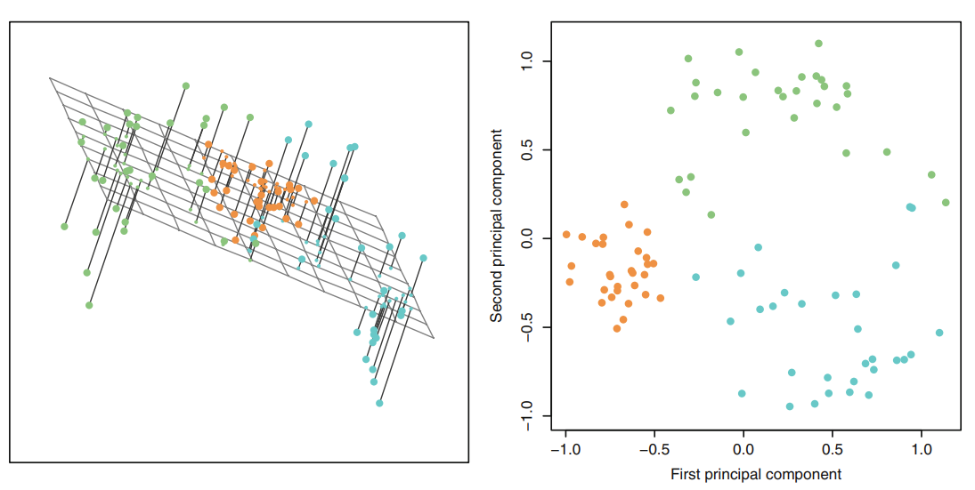
Principal Component Analysis
Principal Component Analysis:

Slide 48
Principal Component Analysis
How do we actually calculate these components?
Let’s walk through the steps visually.

Slide 49
Principal Component Analysis
Begin with a two dimensional data set:

Slide 50
Principal Component Analysis
Begin with a two dimensional data set:
X1 | X2
1 | 2
2 | 1
3 | 2
4 | 4
5 | 3
6 | 5

Slide 51
Principal Component Analysis
Begin with a two dimensional data set:
X1 | X2
1 | 2
2 | 1
3 | 2
4 | 4
5 | 3
6 | 5

Slide 52
Principal Component Analysis
Begin with a two dimensional data set:
X1 | X2
1 | 2
2 | 1
3 | 2
4 | 4
5 | 3
6 | 5

Slide 53
Principal Component Analysis
Standardize the data:
X1 | X2
1 | 2
2 | 1
3 | 2
4 | 4
5 | 3
6 | 5

Slide 54
Principal Component Analysis
Standardize the data:
X1 | X2
1 | 2
2 | 1
3 | 2
4 | 4
5 | 3
6 | 5

Slide 55
Principal Component Analysis
Standardize the data:
X1 | X2
1 | 2
2 | 1
3 | 2
4 | 4
5 | 3
6 | 5

Slide 56
Principal Component Analysis
Standardize the data:
X1 | X2
1 | 2
2 | 1
3 | 2
4 | 4
5 | 3
6 | 5

Slide 57
Principal Component Analysis
Standardize the data:
X1 | X2
1 | 2
2 | 1
3 | 2
4 | 4
5 | 3
6 | 5

Slide 58
Principal Component Analysis
Standardize the data:
X1 | X2
1 | 2
2 | 1
3 | 2
4 | 4
5 | 3
6 | 5

Slide 59
Principal Component Analysis
Standardize the data:
X1 | X2
1 | 2
2 | 1
3 | 2
4 | 4
5 | 3
6 | 5

Slide 60
Principal Component Analysis
Standardize the data:
X1 | X2
1 | 2
2 | 1
3 | 2
4 | 4
5 | 3
6 | 5

Slide 61
Principal Component Analysis
Standardize the data:

Slide 62
Principal Component Analysis
Standardize the data:

Slide 63
Principal Component Analysis
Standardize the data:

Slide 64
Principal Component Analysis
Calculate covariance matrix for data:

Slide 65
Principal Component Analysis
Linear transformation of data:
(1,1)

Slide 66
Principal Component Analysis
Linear transformation of data:
(1,1)
a1 b1
a2 b2

Slide 67
Principal Component Analysis
Linear transformation of data:
(x,y) → (a1*x+b1*y,a2*x+b2*y)
(1,1)
a1 b1
a2 b2

Slide 68
Principal Component Analysis
Linear transformation of data:
(x,y) → (a1*x+b1*y,a2*x+b2*y)
(a1+b1,a2+b2)
(1,1)
a1 b1
a2 b2

Slide 69
Principal Component Analysis
Linear transformation of data:
(x,y) → (a1*x+b1*y,a2*x+b2*y)
a1 b1
a2 b2

Slide 70
Principal Component Analysis
Linear transformation of data:
(x,y) → (a1*x+b1*y,a2*x+b2*y)
a1 b1
a2 b2

Slide 71
Principal Component Analysis
Linear transformation of data:
(x,y) → (a1*x+b1*y,a2*x+b2*y)
a1 b1
a2 b2

Slide 72
Principal Component Analysis
Linear transformation of data:
(x,y) → (a1*x+b1*y,a2*x+b2*y)
a1 b1
a2 b2

Slide 73
Principal Component Analysis
EigenVector: Directional Information
(x,y) → (a1*x+b1*y,a2*x+b2*y)
1
1

Slide 74
Principal Component Analysis
EigenVector: Directional Information
(x,y) → (a1*x+b1*y,a2*x+b2*y)
1
1
2
2

Slide 75
Principal Component Analysis
EigenValue: Magnitude Information
(x,y) → (a1*x+b1*y,a2*x+b2*y)
1
1
2
2
a1 b1
a2 b2

Slide 76
Principal Component Analysis
EigenValue: Magnitude Information
(x,y) → (a1*x+b1*y,a2*x+b2*y)
|√2|
|√8|
1
1
2
2
a1 b1
a2 b2

Slide 77
Principal Component Analysis
Orthogonal EigenVector
(x,y) → (a1*x+b1*y,a2*x+b2*y)

Slide 78
Principal Component Analysis
EigenVector is just a linear transformation
(x,y) → (a1*x+b1*y,a2*x+b2*y)

Slide 79
Principal Component Analysis
Apply Linear Transformation:
Var(X) Cov(X,Y)
Cov(X,Y) Var(Y)

Slide 80
Principal Component Analysis
Apply Linear Transformation:
Var(X) Cov(X,Y)
Cov(X,Y) Var(Y)

Slide 81
Principal Component Analysis
Apply Linear Transformation:
Var(X) Cov(X,Y)
Cov(X,Y) Var(Y)

Slide 82
Principal Component Analysis
EigenValue measures variance explained:
PC1
Var(X) Cov(X,Y)
Cov(X,Y) Var(Y)
PC2

Slide 83
Principal Component Analysis
EigenValue measures variance explained:
Var(X) Cov(X,Y)
Cov(X,Y) Var(Y)

Slide 84
Principal Component Analysis
EigenValue measures variance explained:
Var(X) Cov(X,Y)
Cov(X,Y) Var(Y)

Slide 85
Principal Component Analysis
EigenValue measures variance explained:
Var(X) Cov(X,Y)
Cov(X,Y) Var(Y)

Slide 86
Principal Component Analysis
EigenValue measures variance explained:
Var(X) Cov(X,Y)
Cov(X,Y) Var(Y)
Principal Component 1

Slide 87
Principal Component Analysis
PCA Steps
Get original data
Calculate Covariance Matrix
Calculate EigenVectors
Sort EigenVectors by EigenValues
Choose N largest EigenValues
Project original data onto EigenVectors

Slide 88
Principal Component
Analysis
Manual Implementation

Slide 89
Principal Component
Analysis
Scikit-Learn Implementation

Slide 90
Principal Component
Analysis
Project Exercise Solutions

